Slide 1
Project Review on
Control and Management of Railway System Connected to Microgrid Stations
BY
BUGUDI MOHAN KUMAR -> 20G31A0207​ MALIREADDY LAKSHMAN -> 20G31A0215​ SEELAM RAJASEKHAR -> 20G31A0221​ M FAREED AKRAM -> 21G35A0215
Under The Esteemed Guidance Of
Dr. K. Chithambaraiah Setty _{Ph.D}
HOD(EEE) & Vice-Principal
ST. JOHNS COLLEGE OF ENGINEERING AND TECHNOLOGY, YERRAKOTA

Slide 2
ABSTRACT
INTRODUCTION
EXISTING SYSTEM & DISADVANTAGE
APPLICATIONS & COMPONENTS REQUIRED
BLOCK DIAGRAM
ADVANTAGES
SOFTWARE & HARDWARE REQUIREMENTS
CONCLUSION
CONTENTS

Slide 3
ABSTRACT
This project suggests a techno-economic process for the energy storage by using SCs in the train.
We aim to reduce the energy consumptions.
The proposed design of railway station use PV and wind sources, and batteries for energy storage system (ESS).
SCs are distinguished by high power and a wide number of charge/discharge cycles, they provide low particular energy and a fast charging time.

Slide 4
The proposed design of railway station use PV and wind sources, and batteries for energy storage system (ESS).
SCs are implemented into the ESS where they are alimented breaking phases and from stations by a pantograph installed in an air power line in each stop.
SCs are distinguished by high power and a wide number of charge/discharge cycles, they provide low particular energy and a fast charging time.
The whole system is modeled in MATLAB-Simulink. Simulations for the train and station show the suitability of the suggested powertrain and control strategy.
INTRODUCTION

Slide 5
Existing System: Existing method using a prediction approach, and energy harvesting approach for railway wagon monitoring sensor
Disadvantage:​
High cost​
Need more sensor​
Not proper working

Slide 6
COMPONENTS REQUIRED
Applications
PACK OF SUPER-CAPACITOR
BUCK-BOOST CONVERTER
BATTERIES
PHOTOVOLTAIC PANELS
WIND ENERGY SYSTEM
AC-DC CONVERTER
DC BUS
ENERGY MANAGEMENT SYSTEM
ENERRY STOTAGE SYSTEM
Railway station control system
Electric vehicle

Slide 7
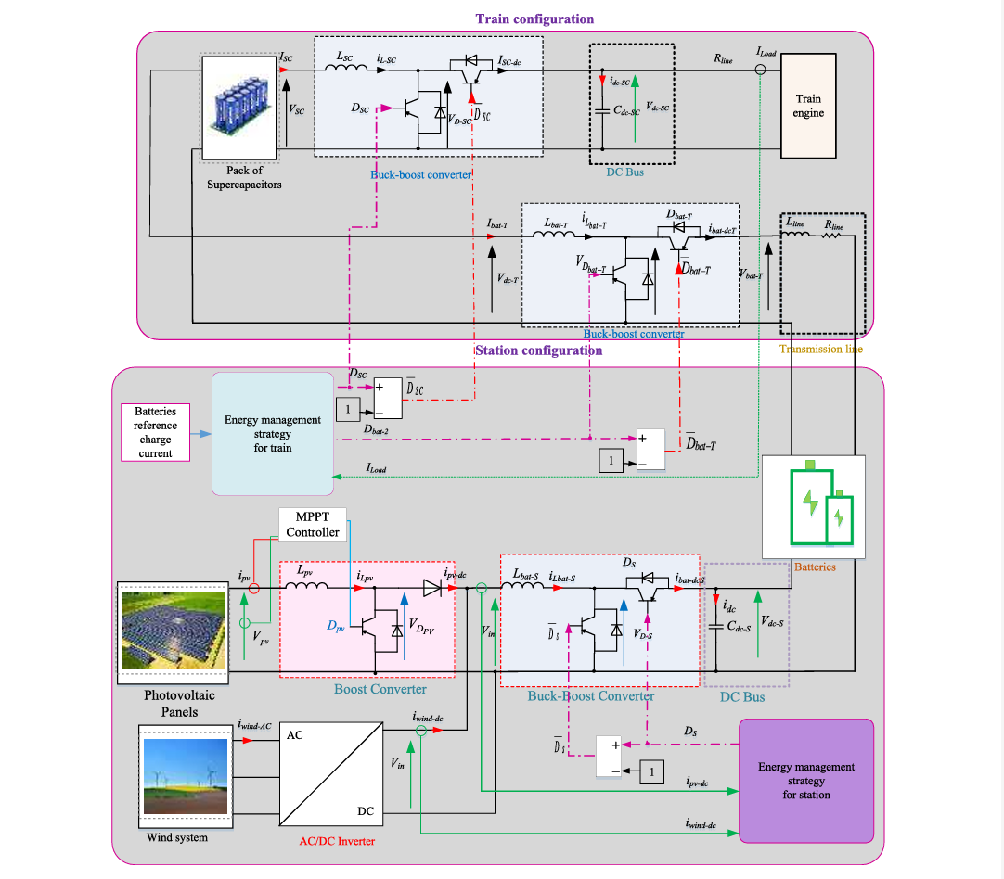
Project Block Diagram: Fig. Circuit diagram of the proposed Method
The proposed design of railway station use PV and wind as energy sources and batteries for energy storage system (ESS).
All system connected for microgrid station.
The proposed system, is composed of two parts:
The first one concern the stations,
The second one is addressed to the control of trains.
The stations are composed PV and wind fields where the energy storage is insured by batteries.
The trains are composed by SCs and engine. SCs are used because of their high power.

Slide 8
Increasing reliability
Aiding economic growth
efficient, low-cost, clean energy,
enhance local resiliency
Improve the operation and stability of the regional electric grid.
Advantages:

Slide 9
Software & Hardware Requirements:
Software Configuration:
Operating System : Windows 7/8/10
Application Software: Matlab/Simulink
Hardware Configuration:
RAM : 8 GB
Processor : I3 / I5 (Mostly prefer)

Slide 10
The proposed techno-economic method for the energy storage by using SCs in the train is presented in this project review.
The studied system is devised on two parts: station and train.
The design of railway station is presented by using PV and wind as principal sources, and batteries for ESS.
The train is composed by engine and SCs.
SCs are used for their fast charge and discharge.
The relative Advantages have proposed.
CONCLUSION

Slide 11
THANK YOU
ANY QUERIES...

